Slide 1
Lecture 2: Introduction to Basic Aerodynamics

Slide 2
READING AND HOMEWORK ASSIGNMENTS
Reading: Introduction to Flight, 7th Edition, by John D. Anderson, Jr.
  Chapter 4

Slide 3
REVIEW OF BASIC DEFINITIONS
Streamline
  Set of points that form a line that is everywhere tangent to local velocity vector
  No flow across streamlines
  For a steady flow, moving fluid element traces out a fixed path in space
Stream tube
  A set of streamlines that intersect a closed loop in space
Steady Flow: A flow that does not fluctuate with time
Unsteady Flow: A flow that varies with time
Equation of State for a Perfect Gas ,applies at a point
  Ideal Gas Law: p = ρRT or pv = RT (v = 1/ρ)
  R universal = 8,314 J/kg mole K
    R for air = 8,314 / 28.96 = 287 J/kg K (or 1,716 ft lb / slug R)

Slide 4
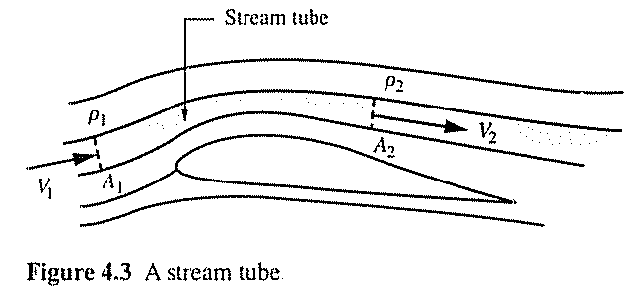
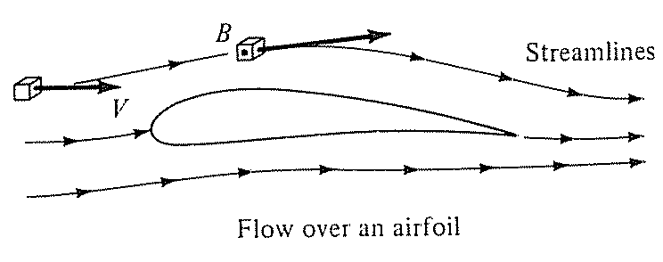
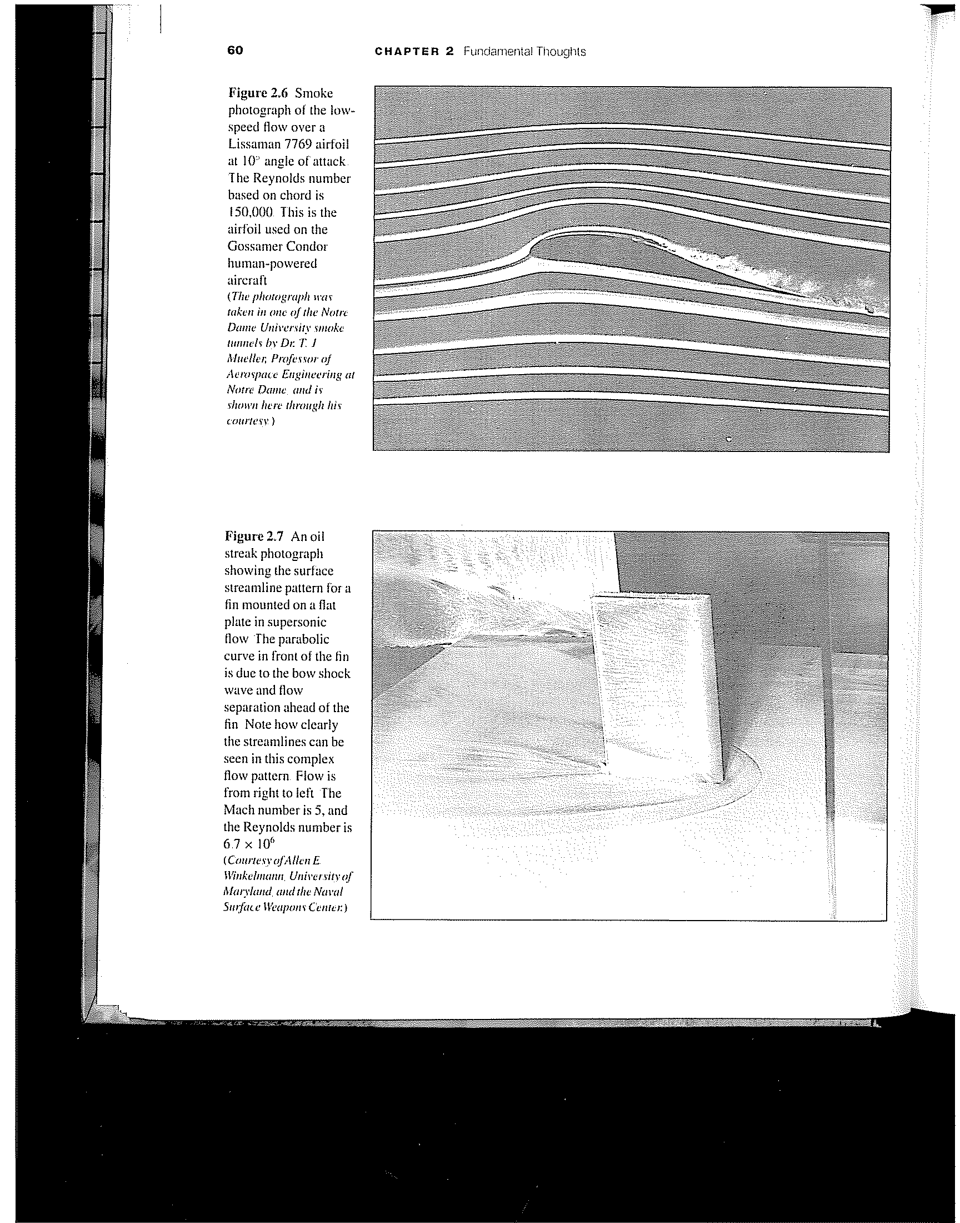
EXAMPLE: STREAMLINES AND STREAM TUBES
IN STEADY FLOW
Streamlines
Stagnation
Point

Slide 5
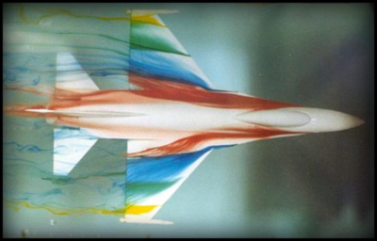
WATER STREAMLINES ON F-16 MODEL
http://www.aerolab.com/water.html

Slide 6
TYPES OF FLOWS: FRICTION VS. NO-FRICTION
Viscous: Flows with friction
  All real flows are viscous
  Inviscid flow is a useful idealization
  By neglecting friction analysis of flow is usually much easier!
Inviscid: Flows with no friction
Flow very close to surface of airfoil is
Influenced by friction and is viscous
(boundary layer flow)
Stall (separation) is a viscous phenomena
Flow away from airfoil is not influenced
by friction and is wholly inviscid

Slide 7
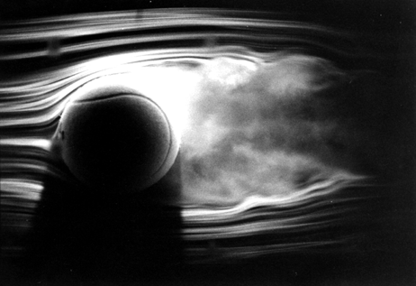
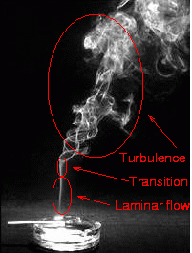
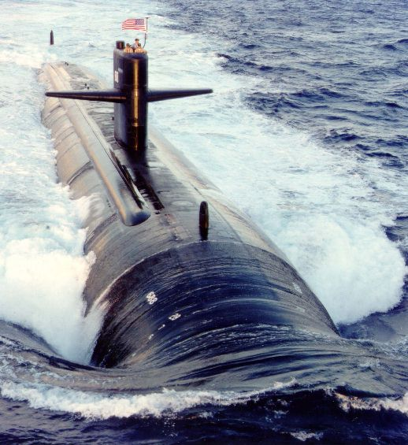
LAMINAR VERSUS TURBULENT FLOW
Two types of viscous flows
  Laminar: streamlines are smooth and regular and a fluid element moves smoothly along a streamline
  Turbulent: streamlines break up and fluid elements move in a random, irregular, and chaotic fashion

Slide 8
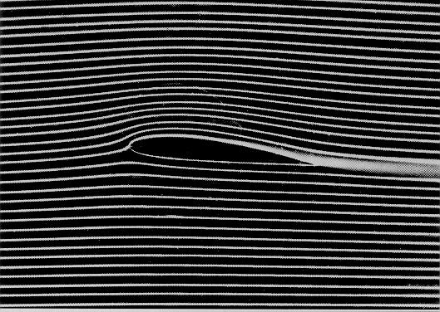
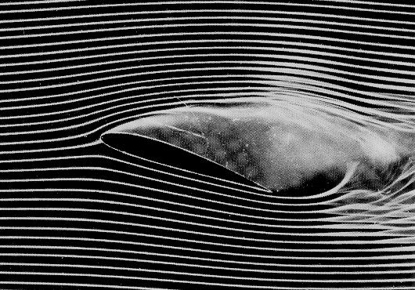
FRCTION EXAMPLE: AIRFOIL STALL
Key to understanding: Friction causes flow separation within boundary layer
  Boundary layers are either laminar or turbulent
  All laminar B.L. → turbulent B.L.
  Turbulent B.L. ‘fuller or fatter’ than laminar B.L., more resistant to separation
Separation creates another form of drag called pressure drag
  Dramatic loss of lift and increase in drag

Slide 9
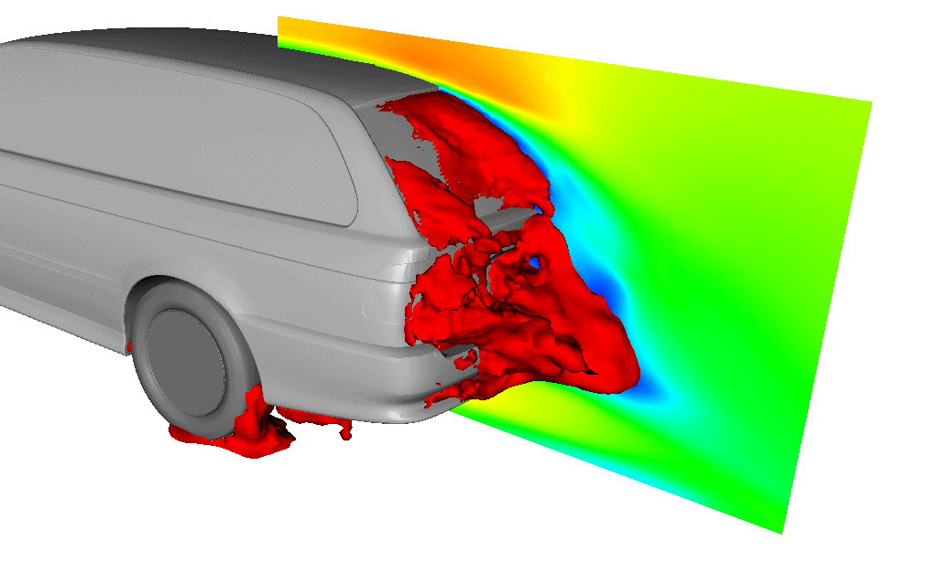
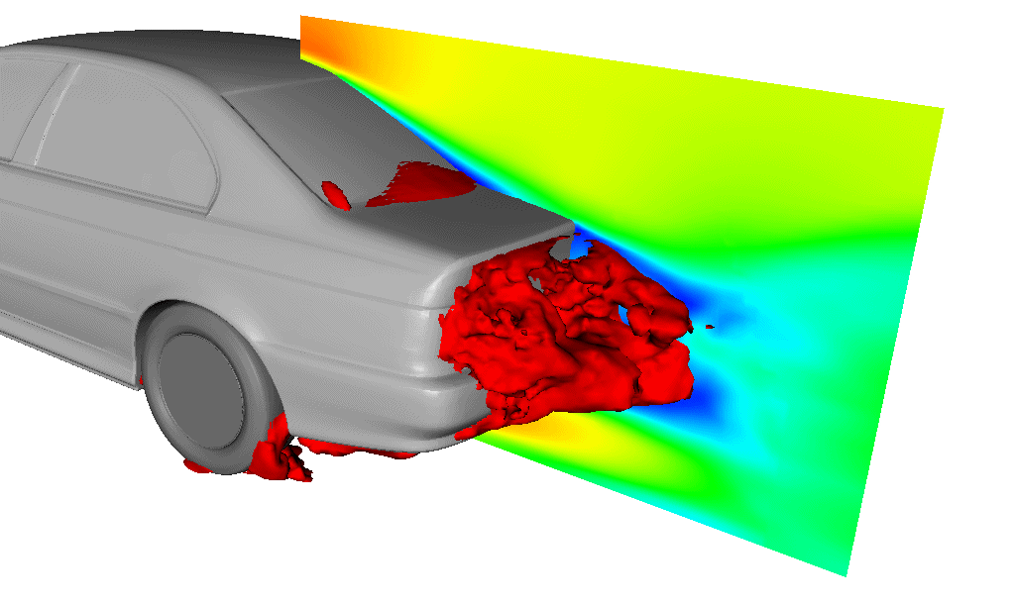
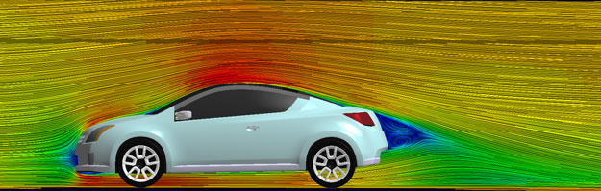
AUTOMOTIVE EXAMPLES
http://exa.com/automotive.html

Slide 10
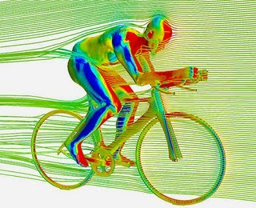
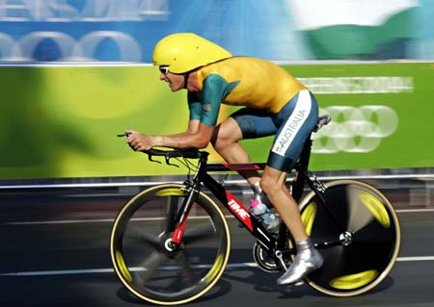


CYCLING AERODYNAMICS
Bike and rider aerodynamics
Peloton vs. single rider

Slide 11
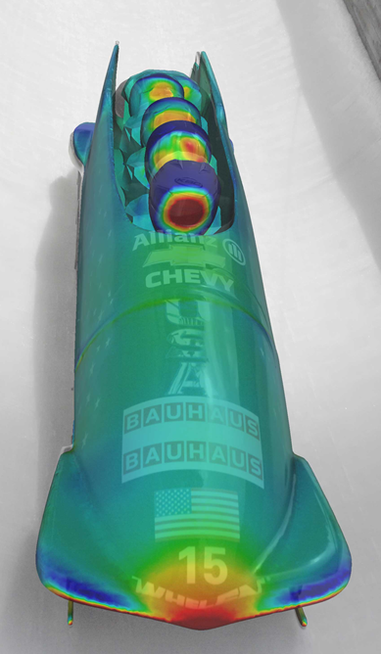
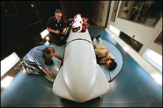
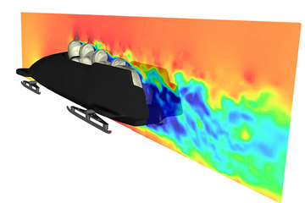
BOBSLED AERODYNAMICS

Slide 12
TYPES OF FLOWS:
COMPRESSIBLE VS. INCOMPRESSIBLE
Compressible: Density of fluid elements may change from point to point
  All real flows are compressible
  Important for gases (rarely important for liquids)
  Most important at high speeds
Incompressible: Density of fluid elements is always constant
General Rule of Thumb:
  If flow speed is less than about 100 m/s (or less than 225 MPH) → flow can be considered incompressible
  or
  If flow is less than Mach 0.3, flow can be considered incompressible
    Mach number, M: ratio of local velocity to local speed of sound, V/a

Slide 13
KEY TERMS: CAN YOU DEFINE THEM?
Streamline
Stream tube
Steady flow
Unsteady flow
Viscid flow
Inviscid flow
Compressible flow
Incompressible flow
Laminar flow
Turbulent flow

Slide 14
BASIC AERODYNAMICS

Slide 15
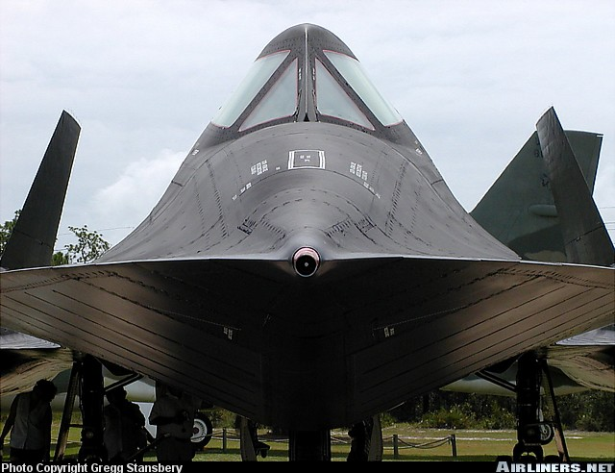
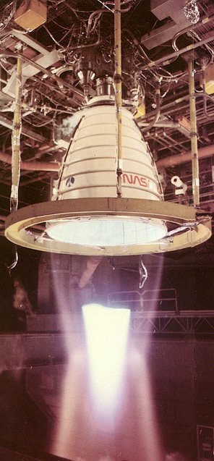
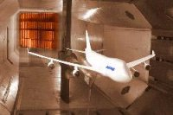
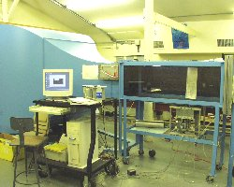
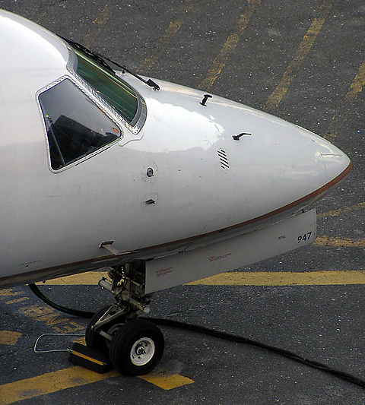
EXAMPLES OF WHAT WE WILL BE ABLE TO DO
Air Speed
Supersonic Flow
Wind Tunnels

Slide 16
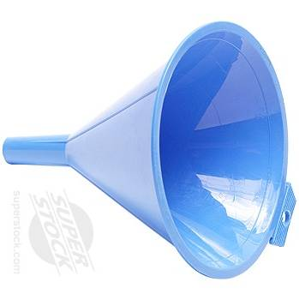
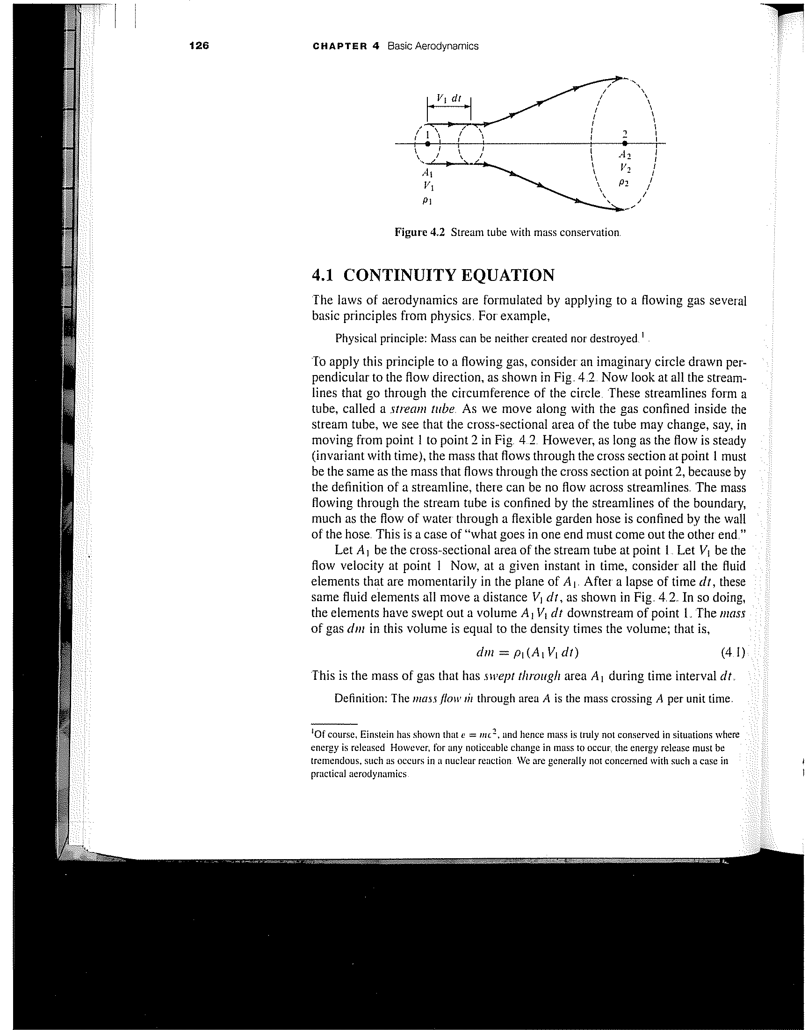
CONSERVATION OF MASS
Stream tube
Funnel wall
A₂
A₁
V₁
V₂
As long as flow is steady, mass that flows through cross section at point 1 (at entrance) must be same as mass that flows through point 2 (at exit)
Flow cannot enter or leave any other way (definition of a stream tube)
Also applies to solid surfaces, pipe, funnel, wind tunnels, airplane engine
“What goes in one side must come out the other side”

Slide 17
CONSERVATION OF MASS (4.1)
Stream tube
A₁: cross-sectional area
of stream tube at 1
V₁: flow velocity
Normal (perpendicular) to A₁
Consider all fluid elements in plane A₁
During time dt, elements have moved V₁dt and swept out volume A₁V₁dt
Mass of fluid swept through A₁ during dt: dm=ρ₁(A₁V₁dt)

Slide 18
SIMPLE EXAMPLE
Given air flow through converging nozzle, what is exit area, A₂?
p₁=1.2x10⁵ N/m²
T₁=330 K
V₁=10 m/s
A₁= 5m²
p₂=?
T₂=?
V₂=30 m/s
A₂=?
IF flow speed < 100 m/s assume flow is incompressible (ρ₁=ρ₂)
Conservation of mass could also give velocity, V₂, if A₂ was known
Conservation of mass tells us nothing about p₂, T₂, etc.

